Slide 1
SQL DATA ANALYSIS &EXPLORATION ASSESSMENT
By Moses Elly

Slide 2
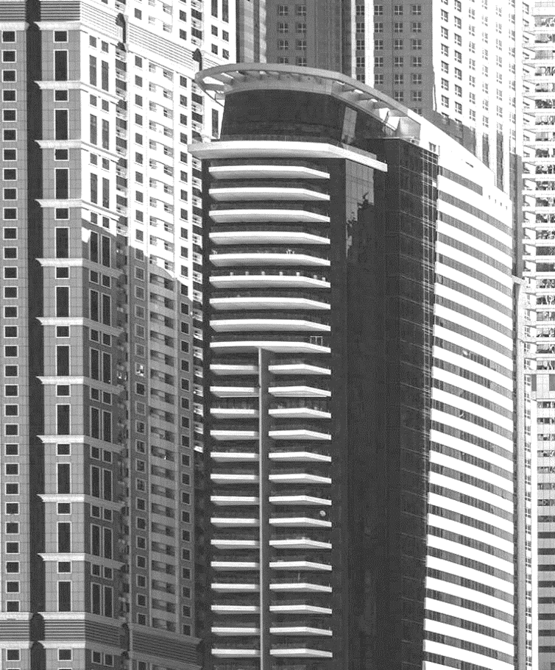
CONTENTS
Initial Data Exploration Findings
Strategic Business Question
Data Cleaning Tasks

Slide 3
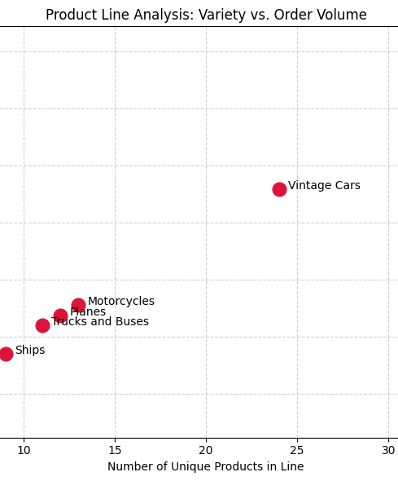
INITIAL EXPLORATION FINDINGS
The database centers on commercial transactions for miniature scale models, heavily weighted toward Classic Cars and Vintage Cars.
There is a direct correlation between a customer's assigned creditLimit in the customers table and their lifetime order volume.
The orders table reveals a subset of transactions with statuses like "Cancelled," "On Hold," or "Disputed," indicating potential operational bottlenecks.
Profit margins (the spread between buyPrice and MSRP in the products table) vary significantly across different product scales and categories.
MSRP: Manufacturer's Suggested Retail Price

Slide 4
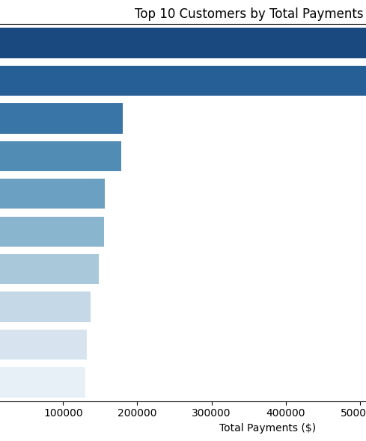
STRATEGIC BUSINESS QUESTION
The Business Question: Based on the sales disparities identified in our initial exploration, which specific scale model product lines and geographic regions experience the highest rate of delayed or cancelled orders, and how does this fulfillment gap impact our overall revenue realization?
Why it matters: Answering this identifies whether our most popular product lines (like Classic Cars) are simultaneously generating our highest logistical costs or revenue leakages.

Slide 5
DATA CLEANING TASKS
Null Handling: Address missing data in the customers.state column (which is frequently NULL for international clients) and the orders.comments column to ensure accurate grouping and text analysis.
Data Standardization: Unify geographic text strings in the customers.country column (e.g., standardizing instances of "USA" vs. "United States" or "UK" vs. "United Kingdom") to ensure accurate regional aggregations.
Data Type Normalization: Validate and convert date strings in orderDate, requiredDate, and shippedDate into standardized DATETIME formats to accurately calculate fulfillment turnaround times.
Integrity Checks: Ensure there are no orphaned records, such as entries in orderdetails that reference a productCode no longer listed in the products table.

Slide 6
Github:
https://github.com/Osesi/Mini/

